Slide 1
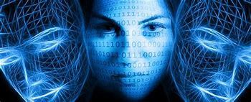
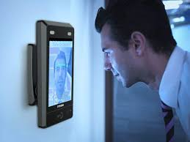
Facial recognition
OUTLINE
DEFINITION
HOW FACIAL RECOGNITION WORKS?
WHY FACIAL RECOGNITION,THEN?
WHAT IS FACIAL RECOGNITION?
Sources thalesgroup.com, cambridge dictionary ,wikipedia.

Slide 2
MEMBERS
FATOUMATA FAYE
MOHAMED NDOYE
AWA NIANG
EL HADJ AMATH SARR

Slide 3
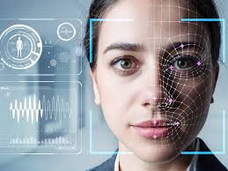
DEFINITION
Facial recognition
Is a technology capable of matching a human face from a digital image or a video frame against a database of faces.
Is a technology that makes it is possible for a computer to recognize a digital
image of someone's face

Slide 4
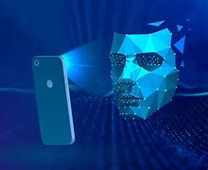
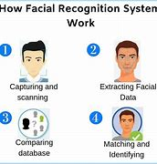
HOW FACIAL RECOGNITION WORKS?

Slide 5
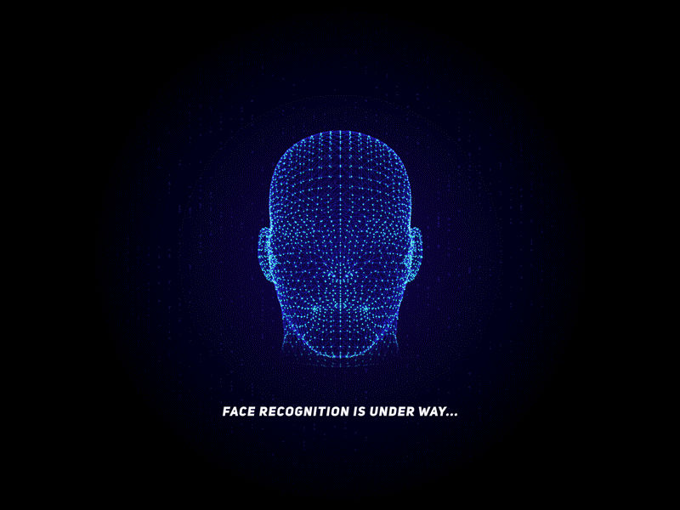
WHY FACIAL RECOGNITION,then?
BECAUSE
It’s much secured
Face detection and face match
processes for verification/
identification is very speed
There is no physical interaction
required by the end-user

Slide 6
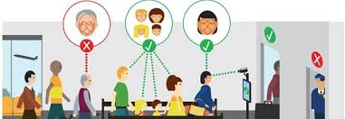
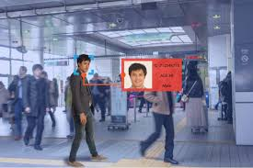
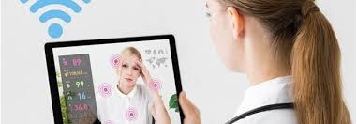
What is facial recognition used for?
MARKETING AND RETAIL
SECURITY
HEALTH

Slide 7


